Slide 1


FYP 2
E - HEALTH
Syed Fazalullah (2173-2021)
S.M Hamza Sohail (2271-2021)
Muaaz Ahmed Baig (1726-2021)
Supervisor
Sir Mohsin Khan
Department of Computing, FEST
Hamdard University

Slide 2
Summary
Problem Statement
Objective
FYP Scope
Our methodology
Our Project Plan (Time lines)
Budget / Costing
FYP Deliverables
References

Slide 3
Problem Statement
The problem statement for the application is made are that when a patient go to the clinic so he has to be waited so long for the doctor and also have to take the appointment by going to that clinic.
As same for the laboratory the patient have to waited for long to make conduct his test.
And for medical store people can’t get the medicine from there nearby medical store.

Slide 4
Objective
The primary objectives of the E-Health project are to design a secure and user-friendly messaging system for efficient communication, develop an intuitive appointment scheduling feature to reduce wait times and improve patient engagement, and create a secure and easily accessible platform for patients to view their medical records and test results.
Additionally, the project aims to improve patient engagement by providing educational resources and health tips, ensure the application meets industry standards for data security and privacy, design an intuitive and user-friendly interface for both doctors and patients, and develop a scalable and flexible application for future updates and feature additions. The overall goal is to create a comprehensive and user-friendly application that improves healthcare outcomes, enhances patient engagement, and streamlines communication between doctors and patients.

Slide 5
FYP Scope
Through this E – Health System, Patients can search clinic or doctors based on specialization, name, or availability.
Patients can receive a token number online for their appointment. Displays the current token number being served and an estimated wait time.
A laboratory management system will work in the same way as a clinic management system.
When scheduling a test, you can see a list of laboratories, their prices, and any other relevant details.
This application will provide online service of medical store and patients can buy their prescribed medicines.

Slide 6
Our Methodology
AGILE _ Methodology
Flexibility: Agile adapts to changing requirements and healthcare needs.
Collaboration: Agile ensures communication and collaboration among team members and stakeholders.
Rapid Feedback: Agile provides continuous feedback and iteration, improving the system's quality and responsiveness.

Slide 7
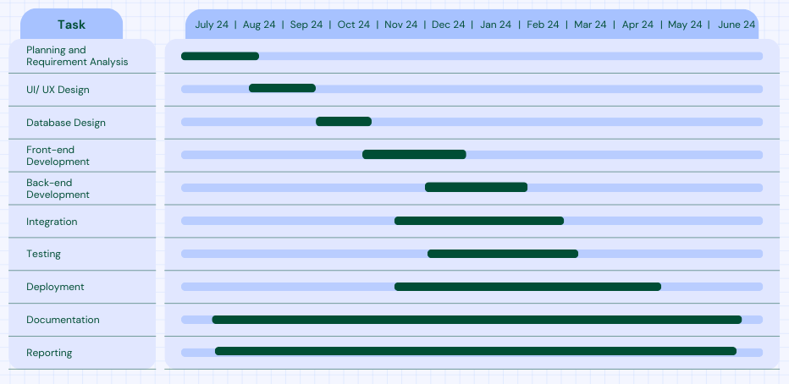
Our Project Plan

Slide 8
Budget / Costing
Internet
Electricity
Fuel Expense
Efforts (3 Person)
Others

Slide 9
FYP Deliverables
FYP-I Evaluation
FYP-II Evaluation
SRS Document
Project Plan
Prototype
Project Report - I
Front-end
Database Design
Back-end
Role base data shown on App
Hosting and Deployment
Project Report - II
Reporting

Slide 10
Reference
https://www.dvago.pk/
https://www.cbc.ca/news/health/hospital-patients-may-worry-less-after- seeing-their -medical-records
https://www.cbc.ca/news/health/patients-gain-when-doctors-notes- are%20online
https://doi.org/10.1145/2379776.2379779
https://doi.org/10.1258/1357633001934113
Online Health Records (2011) https://www.cbc.ca/news/canada/toronto/online-health-records-popular-with

